Slide 1
03-Build your first K8s cluster 🧑‍🏭

Slide 2
What you will learn in this course 🧐🧐
Let's get our hands dirty and build our first cluster! In Kubernetes, there are 3 resources you need to know to get you started with a simple app:
Workloads - refers to an application running on a set of Pods
Services - refers to how Pods are linked together
Ingress - refers to how the cluster is going to be accessible to the open world
In this course, we will cover the basics of these three components

Slide 3
Overview of what we will be building
For this course, we will be running a streamlit application at scale using Kubernetes. Feel free to check the original repo here: Uber Pickups in NYC
To do so, we will need to create three resources handled by the Controller Manager in the Control Plane:
A Deployment Workload
This will be used to create Pods containing our application
A Deployment workload is simply a packaged way to run Pods. It handles failures, replicas etc. Basically, you will write a "desired" state of your application and it will try to bring it to that level.
A Service resource
This will be used to access Pods within the cluster
An Ingress resource
This will open the app to the open world. We'll be able to type https://my_great_streamlit_app.com to access it

Slide 4
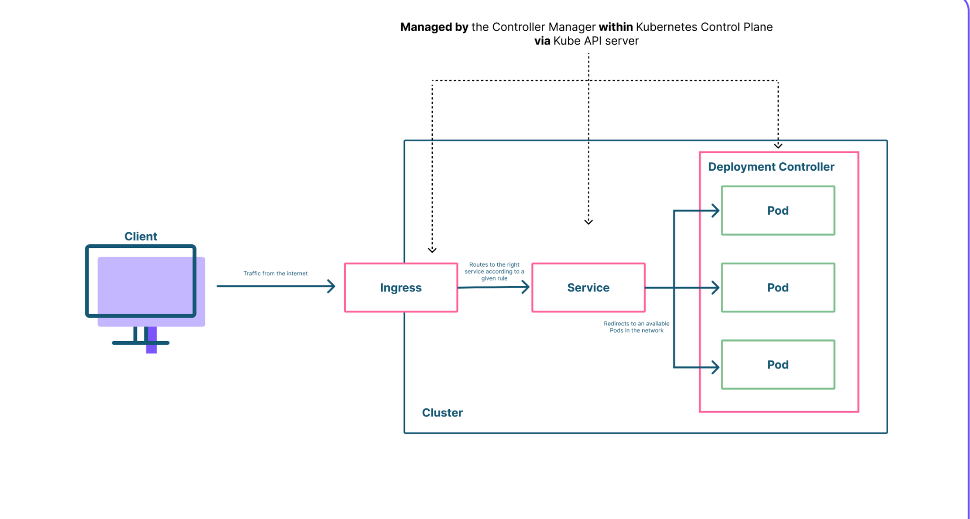

Slide 5
Build the app
Let’s start writing code. First, let's:
define a working directory within your machine
start a minikube cluster - minikube start
👋 For MacOS users: you will need to change driver and run: minikube start --driver=hyperkit
This is due to an error on mac -> Check StackOverflow
Install hyperkit by running: brew install hyperkit
More info here: https://minikube.sigs.k8s.io/docs/drivers/hyperkit/
Once you are done with that go ahead and write code!
Think yaml
When you are setting up a Kubernetes cluster, we will simply write .yaml files and that's it 😯 Yes, you read well, only .yaml files!

Slide 6
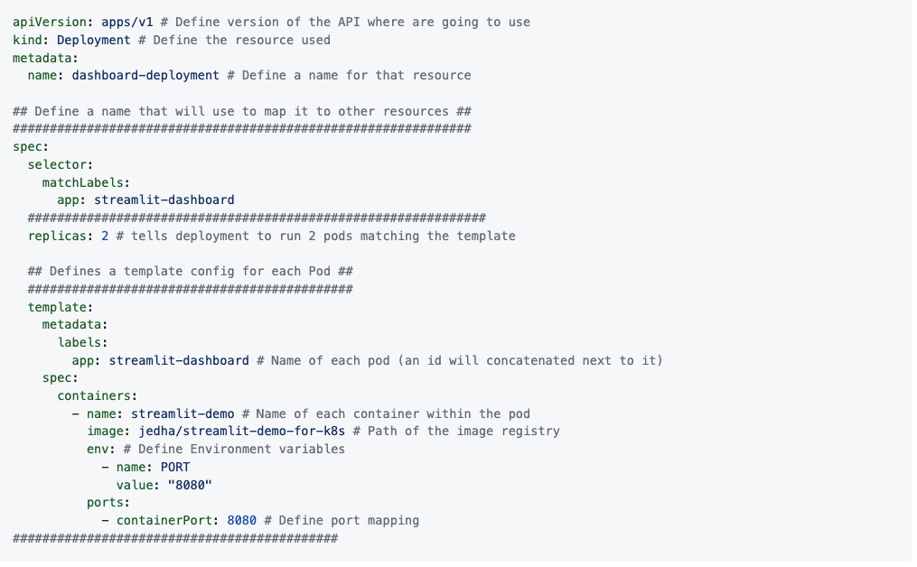
Deployment
Let's start by configuring our Deployment resource. Let's create a file called dashboard-deployment.yaml with the following code:

Slide 7
Deployment
Now let's apply that configuration to our cluster. To do so simply run:
kubectl apply -f dashboard-deployment.yaml 👋 Make sure you run the above command in the working directory dashboard-deployment.yaml is in!
You can check out if everything worked correctly by running:
kubectl get pods You should get the following output NAME READY STATUS RESTARTS AGE
dashboard-deployment-5846c8fc4d-dmqbb 1/1 Running 0 99s
dashboard-deployment-5846c8fc4d-k76bl 1/1 Running 0 99s Don't worry if you see STATUS at stage ContainerCreating, simply wait a minute before rerunning kubectl get pods

Slide 8
Deployment
Get log with kubectl command kubectl logs POD_ID if you want to check out the logs of a given pod, simply replace POD_ID by the name under NAME. For example:
kubectl logs dashboard-deployment-5846c8fc4d-dmqbb. You should get the following output: You can now view your Streamlit app in your browser.
URL: http://0.0.0.0:8080 Everything seems to be working! 👋 Careful, we can't access the app just yet. If you go on http://0.0.0.0:8080, you won't see your app. We still have some setup to do 😉

Slide 9
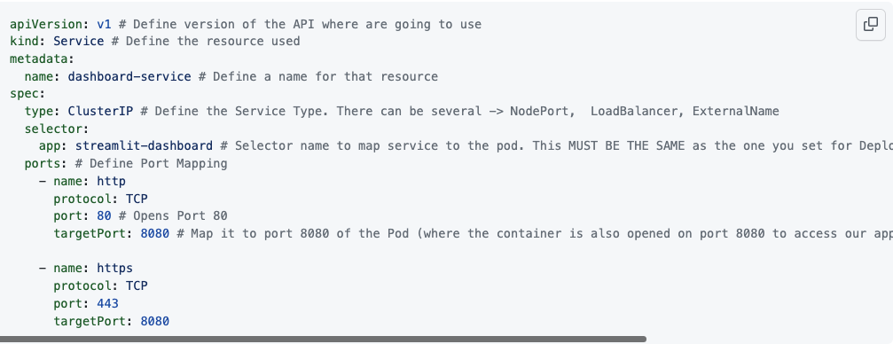
Service
Now that our Pods are up and running. Let's connect them by creating a Service resource. Let's create another file called dashboard-service.yaml with the following code:

Slide 10
Service
In the above example, we are mapping both port 80 (HTTP) and 443 (HTTPS) to port 8080 which corresponds to the open Port on our Pod. In terms of Service types, here is a brief definition of what they are:
ClusterIP: Default Service type. It exposes your application only within the cluster.
NodePort: It exposes the service inside and outside the cluster at a given node port. You'll be able to contact the NodePort Service, from outside the cluster, by requesting <NodeIP>:<NodePort>.
LoadBalancer: It exposes the service outside the cluster using a cloud provider's load balancer (like GCP with GKE, AWS with AKS etc).
ExternalName: It maps the Service to an external resource (like: foo.bar.example.com)

Slide 11
Service
Now let's apply that configuration to our cluster. To do so simply run:
kubectl apply -f dashboard-service.yaml
👋 Make sure you run the above command in the working directory dashboard-service.yaml is in!
You can check if everything works correctly by running:
kubectl get services You should get the following output: NAME TYPE CLUSTER-IP EXTERNAL-IP PORT(S) AGE
dashboard-service ClusterIP 10.102.134.231 <none> 80/TCP,443/TCP 3h10m
kubernetes ClusterIP 10.96.0.1 <none> 443/TCP 3h13m
CLUSTER-IP can be different from your machine to this demo.

Slide 12
Ingress
Finally, let's put up the final piece of configuration to make our application accessible from outside the cluster. To do so, we need to create an Ingress service.
👋 At this point, you might also be wondering why we are building an Ingress instead of using a LoadBalancer or NodePort Service Type. If you haven't, you can skip that part but if you did, we are using Ingress because this resource is really made to connect your cluster to the rest of the world. It handles features like DNS or HTTPS really easily. That is why it has become more and more of a best practice to use an Ingress resource instead of a Service type.
Before we start our configuration, we need to do two things:
Enable ingress addon on minikube. To do so:
minikube addons enable ingress
👋 If you want to know about all the addons there is in minikube 👉 minikube addons list
Create a tunnel to forward local IP to the cluster IP:
minikube tunnel and let your terminal run
Depending on your driver, you will see different outputs

Slide 13
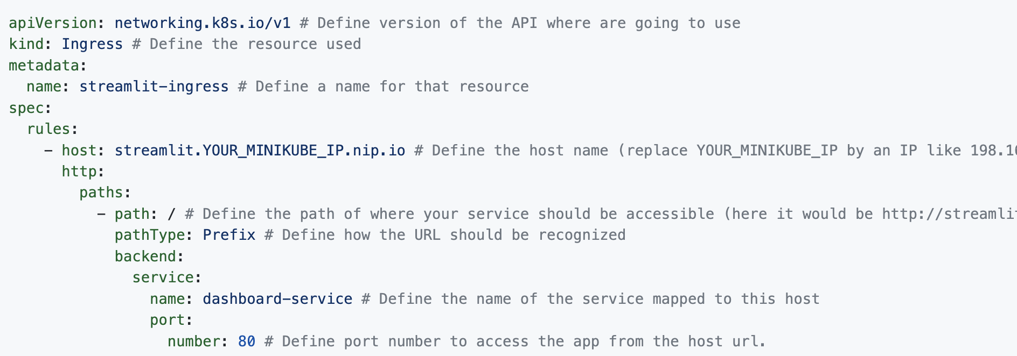
Ingress
Now we can write code 🤗 Let's create a third file called dashboard-ingress.yaml with the following content:

Slide 14
Namespace One final thing that we haven't talked about yet are namespaces
Kubernetes supports multiple virtual clusters backed by the same physical cluster. These virtual clusters are called namespaces. You will usually create several namespaces within the same cluster to:
Separate resources
Seperate users (of your cluster)
Default namespace
You have been using namespaces since the beginning of the course without being aware of it. Namespaces are present as soon as your kubernetes cluster is installed. Here is the list:
$ kubectl get namespace
NAME STATUS AGE
default Active 2d5h kube-node-lease Active 2d5h kube-public Active 2d5h kube-system Active 2d5h

Slide 15
Namespace
You can create a namespace very easily on the command line:
$ kubectl create namespace my-new-namespace
You can now list your namespace:
$ kubectl get namespace
NAME STATUS AGE default Active 2d5h kube-node-lease Active 2d5h kube-public Active 2d5h kube-system Active 2d5h
my-new-namespace Active 9s

Slide 16
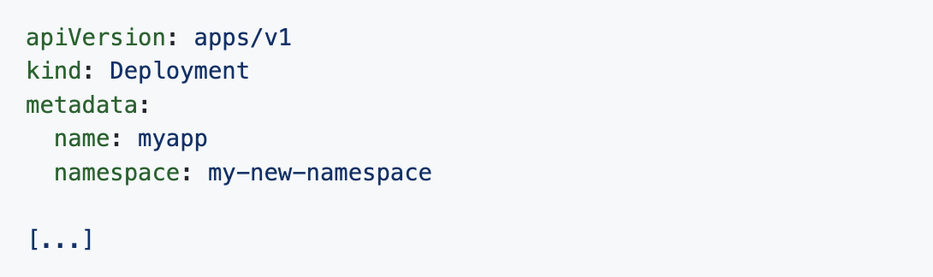
Namespace
Using namespaces in Kubernetes objects
You can now isolate your Kubernetes objects. There are two ways to use your Kubernetes resources in a namespace. Either you define in the metadata list the namespace field, as follows:
Either, just add the -n or --namespace option in your kubectl commands:
$ kubectl run nginx --image=nginx --namespace=my-new-namespace
Your pod will only be visible in the namespace where it was created.
$ kubectl get pods
No resources found in default namespace.
$ kubectl get pods -n my-new-namespace
NAME READY STATUS RESTARTS AGE nginx 1/1 Running 0 2m17s

Slide 17
Namespace
Choose a context
It can sometimes be tedious to specify the namespace used for each command. Here's a method to keep the same namespace without having to specify it each time.
$ kubectl config set-context --current --namespace=my-new-namespace
Context "minikube" modified.
When you have finished working with the namespace you can delete it. All resources that will be inside it will be deleted as well.
$ kubectl delete namespace my-new-namespace

Slide 18
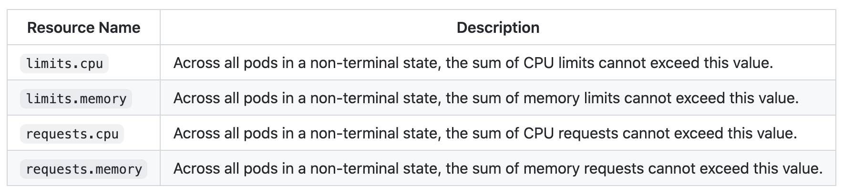
Resource quotas
When several users or teams share a cluster with a fixed number of nodes, there is a concern that one team could use more than its fair share of resources.
Resource quotas are a tool for administrators to address this concern.
A resource quota, defined by a ResourceQuota object, provides constraints that limit aggregate resource consumption per namespace. It can limit the quantity of objects that can be created in a namespace by type, as well as the total amount of compute sresources that may be consumed by resources in that project.
You can limit the total sum of compute resources that can be requested in a given namespace.
The following resource types are supported:

Slide 19
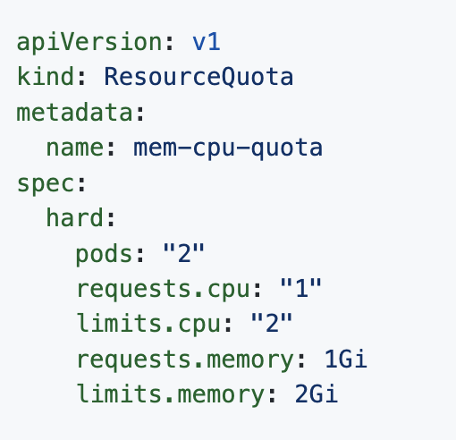
Resource quotas
You can create a Resource quotas object like this:
The defined properties are very simple to understand.
If you try to create an object when the maximum resource is already consumed, the api will send an error.

